Slide 1
Problem Landscape
Bonolo Ditshego

Slide 2
AGENDA
Problem Statement​
​Problem Landscape
​Project Planning: Trello​

Slide 3
PROBLEM STATEMENT
The insurance industry suffers from major losses, despite being a necessary product for the average person.
We will investigate possible reasons why, as well as provide business value, in relaying the key performance metrics, which highlight the issues.
Issues to analyze:
Target Market: Who are the current & potential customers of the business?
Price: What are we charging, and is that excessive or under-cutting us?
Claims to Premium ratio: The proportion of claims filed, in relation to premiums paid by customer?
Which class of claims contribute to our loss making?

Slide 4
PROJECT LANDSCAPE
 | Data | Information | Knowledge | Insights
Target Market | -Where can we get demographics data? -Who owns these data sources? -How do we get access & permission to the data? | -Is there a data dictionary/glossary, explaining field names? -How frequently is the data generated? -What methods of attraction have been used before? | -Who can interpret the data, as an expert in the insurance field? -What technology will we need to solve this issue? -How did we expand our customer base before: i.e. when we first started? | -Who is in our current database? -Which demographic is not in our customer base? -How can we increase our customer base?
Pricing | -Where can we get competitors pricing, as a data source? -How do we get access to competitors premium pricing criterion? Where do we get data on what people want to pay as a premium? | -What are the prices offered by our competitors, per KPI? -How often to competitors change their prices? -How are competitors affected when they change prices? | -Which experts do we need to decide how to fix/change our prices? -When is the best time to change prices? -How will be change prices? -What impact will price changes have? | -Should we in/decrease our premiums? -Should we in/decrease our claims range? -How are we priced, in relation to our competitors (margins)?
Claims to Premium | Where can we get data on which class is typically claimed? -Where do we get data on the premium that is charged for certain user personas? | -Who claims the most? -Who misses their premiums? -What is the claims to premium ratio? | -Can we introduce a claims limit? -Can we increase premiums? -Who can we do the above to, and still retain? | -Do people lodge higher claims, than the premiums they’ve paid? -Who lodges claims frequently?
Claims Class | -Where do we get data on the insurance categories that can be claimed for? -Where do we get data on competitors chosen classes to insure? | -What is the class distribution? -Which class can be dropped? | -Which class contributes most? -What rate to customers move between each class? -When do customers move between classes? | -Which class of claims is lodged most? -Which class of people claim frequently?

Slide 5
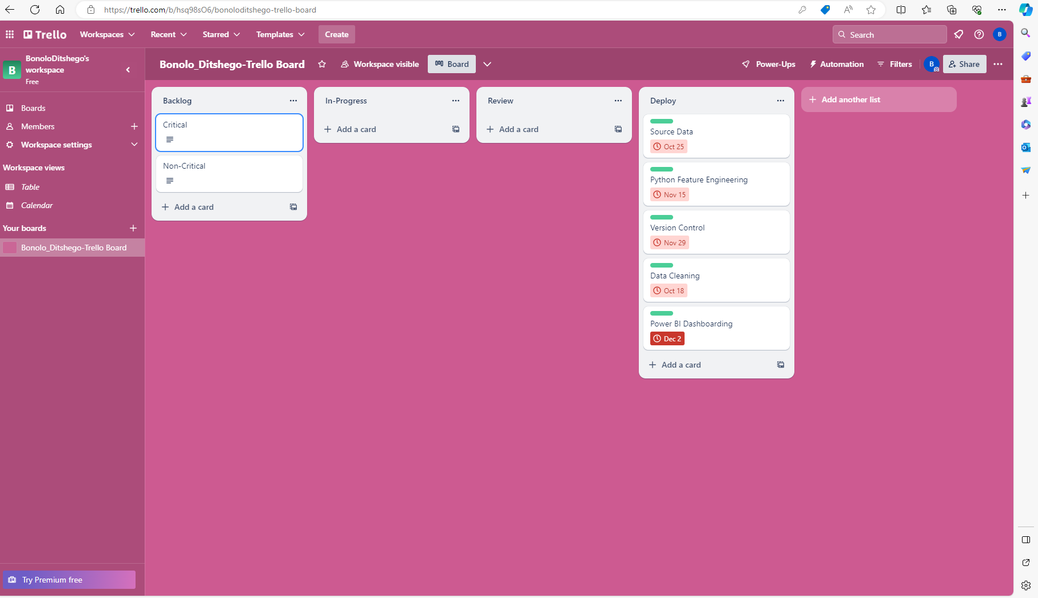





PROJECT PLANNING
PLANNING
MARKETING
DESIGN
STRATEGY
DEPLOY
Synergize scalable e-commerce
Disseminate standardized metrics
Coordinate e- business applications
Foster holistically superior methodologies
Deploy strategic networks with compelling e- business needs

Slide 6
THANK YOU

